Slide 1
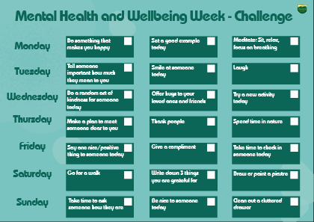
Mental Health Week
This week is Mental Health and Wellbeing week:
All Citizenship lessons will include a focus on mental health and wellbeing.
Wellbeing support desk in the heart space over two lunch periods.
One week challenge card for staff and students to complete.
Showing of ‘Inside Out’ in the theatre on Thursday and Friday over lunchtime.
Short video on PAPYRUS (suicidal thoughts) included in Form Time on Tuesday.
Key focus display of mental health and awareness books in the library.
PTO for more detail

Slide 2
Mental Health Week
All students in Y7 will get a physical copy of this. All other year groups will be sent a copy or can pick a copy up from student reception.
Students pick one at least one challenge per day. Tasks can be signed off by parents and staff.
Each completed card (with name) will be given an achievement point.
All completed cards will be placed in a draw for a wellbeing journal, book and infinity pad.

