Slide 1
Note to teachers:
The following topics are covered in greater depth in the 16+ lesson:
What’s in a name?
Standing out from the crowd
Stand up and speak out

Slide 2
Feedback: “Would you want to be a
politician right now?”
“I love the idea that by using my voice I am making a positive impact on people's lives. However, I do feel that being part of a BAME group, and also being female, would have an impact on my experience greatly as I feel that we are very underrepresented. Whilst this would present to be an issue, I would love the opportunity to add diversity to parliament whilst helping the country.”
Christ’s Hospital School
“I would not be able to handle the stress of being a politician. Being in the public eye all the time would terrify me. I know I wouldn’t be able all the hate and ridicule that Politicians get every day.”
St Mary’s School for Girls
“there will always be people who will disagree, even if it’s the best decision on for the country, you will also be constantly getting hate.”
St Wilfrid’s Church of England Academy
Yes
No
17.8%
82.2%
“As much as I want to have my voice heard, being a politician takes a lot of time and effort and I think Boris Johnson and the Government are doing a great job.”
Sutton Coldfield Grammar School for Girls

Slide 3
Feedback: “Would you want to be a
politician right now?”
Well done to all the young people who cast their votes in VotesforSchools as part of UK Parliament Week. It’s great to see young people getting involved and expressing their views – that’s exactly what UK Parliament Week is all about. Voting is such an important way to have your say and get your voice heard – keep it up! We wish these future voters and future politicians all the very best on their democratic journeys!
Comment on behalf of the team at UK Parliament Week!
The VoteTopic results were also shared with…
Youth Politics UK
British Youth Council
Leader of the House of Commons
UK Parliament Week
The Children’s Commissioner
Notes:
Images
https://youthpolitics.org.uk/
https://www.byc.org.uk/uk/uk-youth-parliament
https://twitter.com/commonsleader
https://www.ukparliamentweek.org/en/?s=UK+Parliament+week+funding
https://www.childrenscommissioner.gov.uk/

Slide 4
Is it important to fit in at school?
Notes:
Images
iStock
References

Slide 5
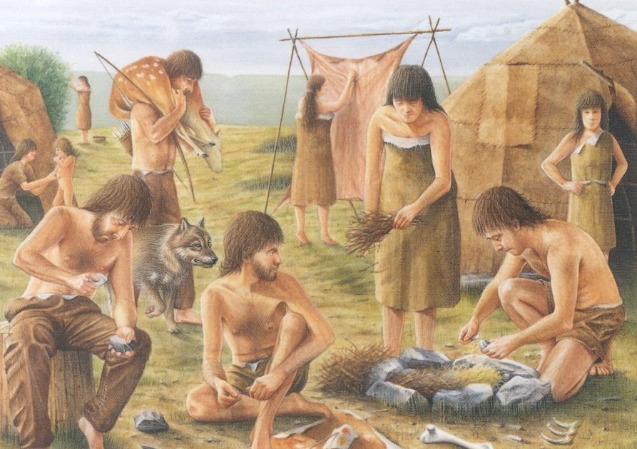
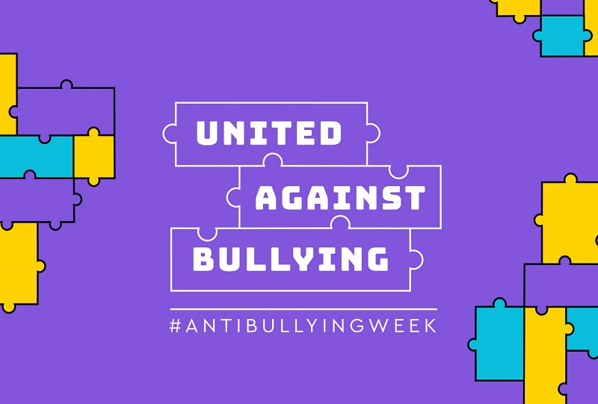
1
Why are we talking about this?
The desire to fit in comes from our survival instincts – as thousands of years ago, it was easier to get food, find shelter and avoid enemies when we were in groups.
While we don’t need these survival instincts quite as much as we used to, they’ve still stayed with us. It’s clear for many of us to see, particularly in school, how there’s safety in numbers…
It’s Anti-Bullying Week this week, which is a great time to celebrate our differences and be ourselves. But, is this sometimes replaced by the need to fit in? That’s what we’ll be thinking about today.
First impressions (1 min)
Do you think it’s important to fit in at school?
Notes:
Images
iStock
https://www.anti-bullyingalliance.org.uk/anti-bullying-week/anti-bullying-week-2020-united-against-bullying
https://liveknowledgeworld.wordpress.com/2013/12/10/inventors-of-the-stone-age/
References
https://www.anti-bullyingalliance.org.uk/anti-bullying-week/anti-bullying-week-2020-united-against-bullying
https://liveknowledgeworld.wordpress.com/2013/12/10/inventors-of-the-stone-age/

Slide 6
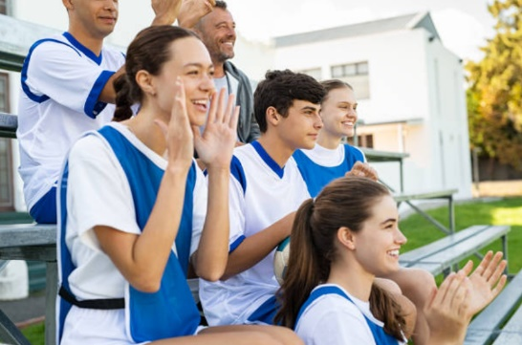
2
Celebrating our differences
Discussion (2-4 mins)
Have a think about your daily school life. How or when are the students in your school encouraged to show off and stand out? Consider the questions below and explain your reasons.
How does your school encourage you?
How do you encourage other people?
How do your friends or classmates encourage you?
Challenge:
Do you enjoy standing out? For instance, if your achievements are acknowledged in an assembly, does that make you proud or embarrassed?!
Not in the classroom?
Jot down your ideas.
Notes:
Images
Icons8
iStock

Slide 7
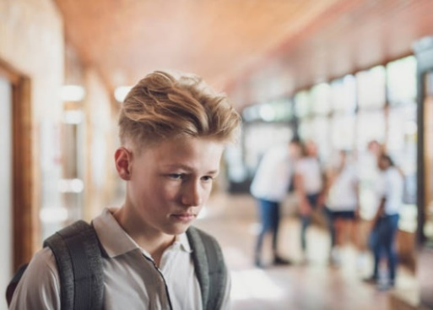
3
But everyone else was doing it…
While things like awareness days and achievement assemblies encourage us to stand out, be yourself and celebrate our differences, how easy is it really?
Pair discussion (6-12 mins)
On the next few slides, you’ll see different scenarios where students aren’t sure whether they want to fit in or stand out. Read each one and discuss the following questions with your partner:
What are they doing to fit in?
Why are they choosing to fit in instead of standing out?
What would you do in their situation?
Challenge:
Would you consider it bullying? Why or why not?
Notes:
Images
iStock
References

Slide 8
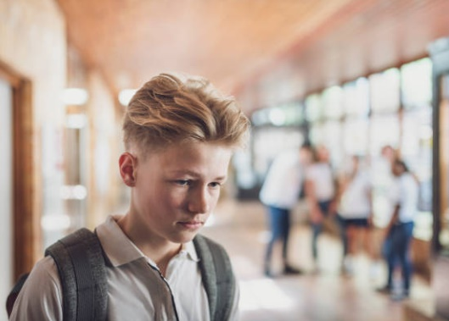
3
But everyone else was doing it…
There’s a kid in our class that I don’t really know, who no one really likes. I’m not sure why, he’s just a bit… weird.
Some of the others make fun of him sometimes, and I occasionally laugh along too… But really, I’m starting to think they’re pushing it a bit far. He isn’t my friend or anything, so I probably won’t say anything, but I do feel a bit bad for him.
Read the scenario and discuss:
What is he doing to fit in?
Why is he choosing to laugh instead of saying what he thinks?
What would you do in his situation?
Would you say that the speaker is bullying? Why or why not?
Notes:
Images
iStock

Slide 9
3
But everyone else was doing it…
I really like trying new styles with my hair. Sometimes they can be a bit different, but I really enjoy it anyway!
Recently, some of my friends have started making fun of me when I get to school in the mornings, which makes me feel really self-conscious. So, I’ve started wearing my hair the same as everyone else. I miss showing off the different things I can do with it, but at least I’m not being mocked anymore.
Read the scenario and discuss:
What did she do to fit in?
Why do you think she chose to fit in instead of standing out?
What would you do in her situation?
Would you say her friends were bullying her? Why or why not?
Notes:
Images
iStock

Slide 10
3
But everyone else was doing it…
The other day at breaktime, my friend took a really ugly picture of me. I asked him to delete it, but some other kids thought it was really funny and begged him to send it to them, so he did.
Now they’re all sending it around and laughing at me. I asked my friend why he did it and he says he doesn’t know and he’s sorry. How can I trust him after he blatantly chose them over me?
Read the scenario and discuss:
What did his friend do to fit in?
Why do you think he sent the photo instead of deleting it?
What would you do in their situation?
Would you call his friend a bully? Why or why not?
Notes:
Images
iStock

Slide 11
3
But everyone else was doing it…
I recently started at a new school with my friend, Jada. I’ve made some really cool new friends… but they don’t really like Jada. They say she’s boring and a teacher’s pet. The jokes they make about her are actually pretty funny, and I make fun of her when she’s not there.
I still like Jada and talk to her or WhatsApp her a lot, just not when my new friends are around.
Read the scenario and discuss:
What is she doing to fit in?
Why do you think she’s joining in instead of defending her friend?
What would you do in her situation?
Would you call her a bully? Why or why not?
Notes:
Images
iStock

Slide 12
4
Teacher’s Note:
Skip if short on time.
Fit in or stand out?
Reflect (2-3 mins)
Based on what you’ve looked at/your own experiences, what challenges do you think come with standing out?
You might…
If…
Other people may…
It can be harder when…
Not in the classroom?
Mind-map your ideas.
Challenge:
Do you feel comfortable standing out in your school, or do you prefer to fit in with everyone else?
Notes:
Images
iStock

Slide 13
Learn more: Is a label-free life possible?
0:00-7:40
Schools are places in which labels often carry a lot of significance, for better or for worse. Click to hear a talk by US student, Martha Fishburne, about her experience of labels and why she thinks we need to start “label-free” schools. How much of her experience resonated with you? Have a think while you watch.
Career Spotlight:
What kind of person do you think it takes to make everyone feel like they belong? This week, we’d like you to design the ideal CV for a Diversity & Inclusion Officer for your school! Think about what sort of skills they should have, any experience they need, and what their responsibilities might be.
Feel free to email your ideas to aisling@votesforschools.com!
Notes:
Alternative Video Link – Learn More: https://youtu.be/Ydww1EnQGo4?t=10
Images
Via video
iStock

Slide 14
Is it important to fit in at school?
Making friends and joining groups is an important part of school life.
Things are just easier if you fit in than if you stand out.
The pressure to fit in is incredibly high when you’re at school, so sometimes it’s impossible to ignore.
Sometimes it’s easier to go along with the crowd, even if you know it’s not right.
Fitting in is boring, standing out is much more fun!
It’s always important to be yourself, even if that means not fitting in.
School should be a time where you find out who you are and what you enjoy; you can’t do that if your only focus is fitting in.
Doing the right thing is more important than fitting in.
We will be sharing your thoughts on this topic with the Anti-Bullying Alliance, Ditch the Label, the NSPCC, Bullying UK, and some famous faces who have shared their experiences of bullying.
Notes:
References

Slide 15
Vote!
In the classroom?
Log your class’s votes now at: www.votesforschools.com/login/teacher
At home?
Follow this link to vote:
https://www.surveymonkey.co.uk/r/vfs-secondary-fitting-in
Not sure how?
Click the ballot box to see a video on how to log your votes!
Not sure how?
Click the link or copy and paste it into your internet browser!
If you have any issues, feedback or comments, email aisling@votesforschools.com.
Notes:
SurveyMonkey Link: https://www.surveymonkey.co.uk/r/vfs-secondary-fitting-in
SafeShare How-To Video Link: https://safeshare.tv/x/N0-AjP3cFjg
YouTube How-To Link: https://www.youtube.com/watch?v=N0-AjP3cFjg&feature=youtu.be

